Slide 1
Welcome to
Total Quality Management
(19MEE347)
Unit 3 – Quality Audit
Name: Dr. Sunil Kumar
Department of Mechanical Engineering

Slide 2
Quality Audit - Definition
A systematic and independent examination to determine whether quality activities and related results comply with planned arrangements, and whether these arrangements are implemented effectively and are suitable to achieve objectives.

Slide 3
Quality Audit - Goal
To collect objective evidence to permit an informed judgement about the status of the systems or product being audited.

Slide 4
Quality Audit - Types
Internal (First Party, Self)
  This type includes audits by company employees, consultants and contractors

Slide 5
Quality Audit - Types
External
  Supplier Audit
    Second Party:
      Customer employee audit your company
      or
      Your employee audit a company which supplies your company with a product or service

Slide 6
Quality Audit - Types
External
  Independent Organization
    Third Party:
      Customer wants an audit of your company

Slide 7
Quality Audit Sub - Types
Compliance (do we comply with the standard)
  Example: Desk audit of high level systems
System (the theory)
  Example: Audit of Document control
Process (the practice)
  Example: Audit of any process (manufacturing)
Product (the result)
  Example: Audit of finished products to fulfill technical specifications

Slide 8
Audit terms Definitions
Auditor: A person who has appropriate qualifications and performs audits.
Client: A person or organization requesting the audit.
  For Internal audits, this is the Management Representative
Auditee: An organization, facility or person being audited.
Quality System: The organizational structure, responsibilities, procedures, processes and resources for implementing quality management.

Slide 9
Audit terms Definitions
Observation: A statement of fact made during an audit and substantiated by objective evidence.
Nonconformity: The non-fulfilment of specified requirements.
Objective Evidence: Qualitative or quantitative information, records or statements of fact pertaining to the quality of an item or service or to the existence and implementation of a quality system element, which is based on observation, measurement or test and which can be verified.

Slide 10
Who performs an Audit?
(A) Imposed Upon Manufacturer / Supplier
Regulatory
Customer or Potential Customer
Third party (on behalf of customer)

Slide 11
Who performs an Audit?
(B) Performed by Manufacturer
Internal (Self inspection)
External

Slide 12
Who performs an Audit?
External
Supplier Contract Manufacturer Contract Packager Of contract Warehouse / distributor
Internal (Self - Inspection)
Overall Departmental Product – oriented System – oriented

Slide 13
Reasons for Quality Audit
Internal:
Determine the level of compliance
Build confidence (hopefully) in GMP and the QA system
Build interdepartmental trust, understanding and communication
Determine measures necessary to improve
Premises, Equipment and Environment
Operations, actions, procedures
Personnel / Training
Provide a stimulus for improvement
Recommend corrective action
Monitor improvement

Slide 14
Reasons for Quality Audit
External:
Establish and monitor capability of supplier or contractor to deliver
Goods and services that are fit for purpose
Build mutual confidence
Promote understanding and communication between the parties involved
And in general, as listed for ‘internal’

Slide 15
Steps in Quality Audit
Plan and Prepare
Arrange and Announce
Arrive at site of Audit, meet, explain, purpose
Perform Audit
Informal oral report of finding
Formal report with recommendations
Follow-up

Slide 16
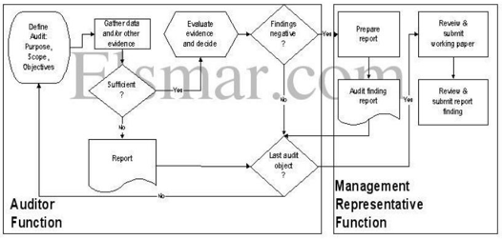
Typical Audit system

Slide 17
Process Audit
Examination of
Established methods
Instructions
Work flow for processes
Maintenance programs for production equipment
Material handling
Housekeeping around the work area

Slide 18
Process Audit
Here company’s procedures are validated
Processes are sub-parts of a system
  Process audits are generally a part of larger system audit
  However, they can be performed independently
    An internal audit may indicate need to perform a specific process audit.
Almost always, one or more other processes will interact with any given process.
One very important issue to consider in the effectiveness of communications between systems and processes.

Slide 19
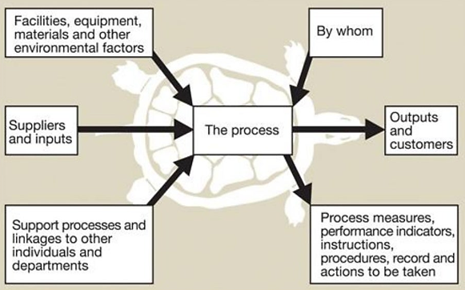
Inter-relationship between different processes

Slide 20
Tools of the Auditor
1. Documents
Quality and GMP regulations, standards, and guidelines
Previous audit and follow-up reports
Auditee’s own documents and records
Audit checklists
  Requires that auditor evaluates a certain number of procedures, plans and documents
2. The auditors own eyes, ears, brain, words, character, etc.
3. Auditing plan

Slide 21
THANK YOU!!!

